Slide 1



eग्रामपंचायत
One step towards आत्मनिर्भर भारत

Slide 2
PROBLEM DEFINITION.
Online and secure payment gateway to pay revenue taxes online.
Provide receipt of payment in pdf format.
Floating a govt. schemes on website to provide awareness among villagers.
Admin dashboard to maintain transaction data of revenue taxes and decide revenue taxes.
Villagers can apply for residential certificate online.
Villagers will get certificate through email after complete process.

Slide 3
MOTIVATION.
Let the villages of the future live in our imagination, so that we might one day come to live in them!
--Mahatma Gandhi(Nationalist and political leader)
Build a system for villagers to be aware of govt. schemes and notify them about revenue taxes of farm,water and home.
This project can be scaled to bring the Gram Panchayat at the fingertips of the Villager.
Our aim is to develop a robust and secure system which will be adopted by govt. for all villages.

Slide 4
OBJECTIVES.
To establish a connection between gram panchayat and villagers for official work,maintaining revenue payment records.
Villagers can apply for residential certificate online except of visiting gram panchayat office.
Provide secure and fast payment gateway for villagers to pay their home,farm and water related revenue taxes.
Floating govt. schemes related to farmers on web application.
This web application is compatible Windows,Ubantu,Mac etc.

Slide 5
Literature Survey
E-Gram Panchayat : https://www.ijresm.com/Vol.3_2020/Vol3_Iss4_April20/IJRESM_V3_I4_85.pdf
E-Gram Panchayat Management System : https://www.ijresm.com/Vol.3_2020/Vol3_Iss5_May20/IJRESM_V3_I5_24.pdf
Building an alternative e-governance model : lessons from e-Gram in Gujarat : https://idl-bnc-idrc.dspacedirect.org/handle/10625/41775
E-GRAM PANCHAYAT MANAGEMENT SYSTEM : http://oaijse.com/
Hurdles in rural e-government projects in India: lessons for developing countries : http://citeseerx.ist.psu.edu
nodejs : https://nodejs.org/en/docs/
expressjs : https://expressjs.com/
Reactjs : https://reactjs.org/docs/getting-started.html
MongoDB : https://docs.mongodb.com/

Slide 6
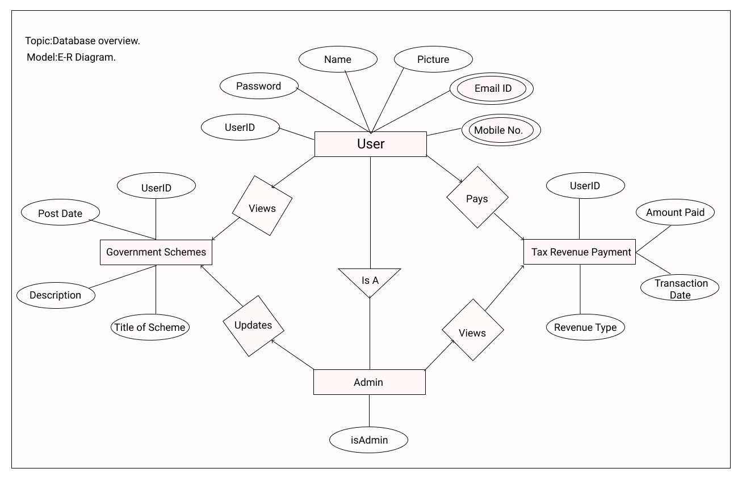
ER Diagram

Slide 7
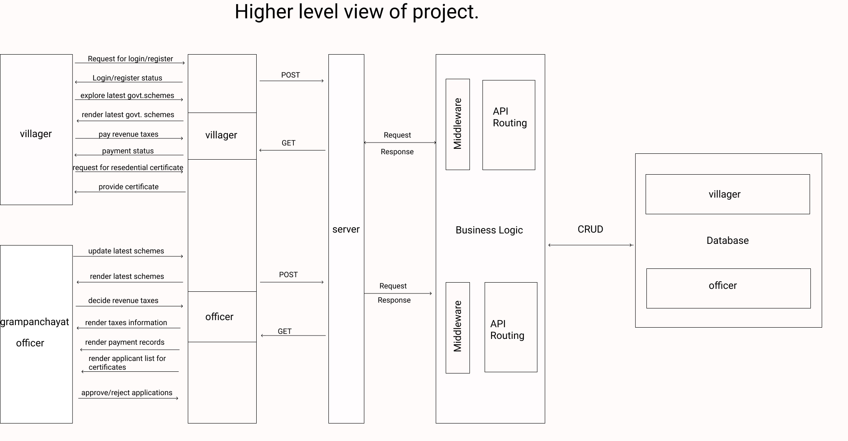
ARCHIETECTURE.

Slide 8
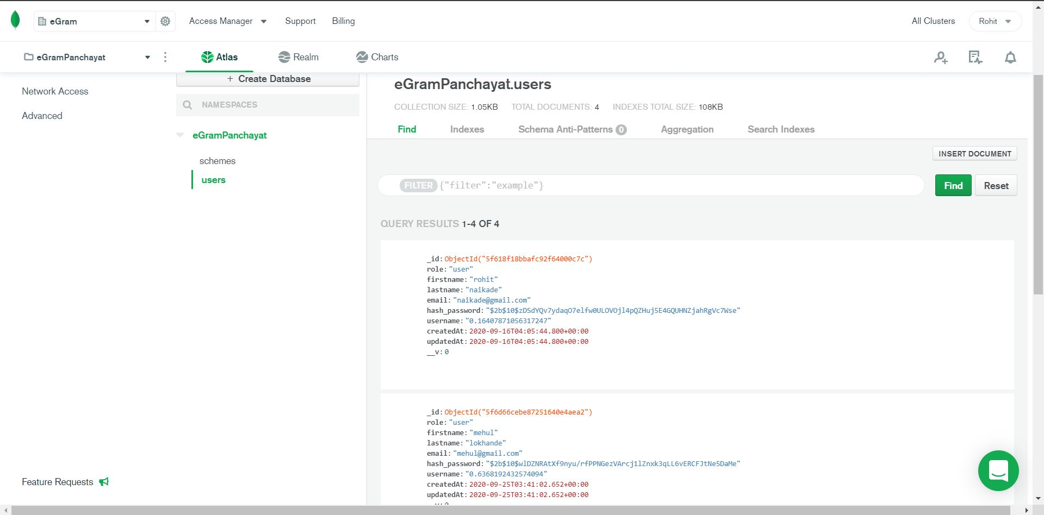
DATABASE SCHEMA FOR LOGIN MODULE.

Slide 9
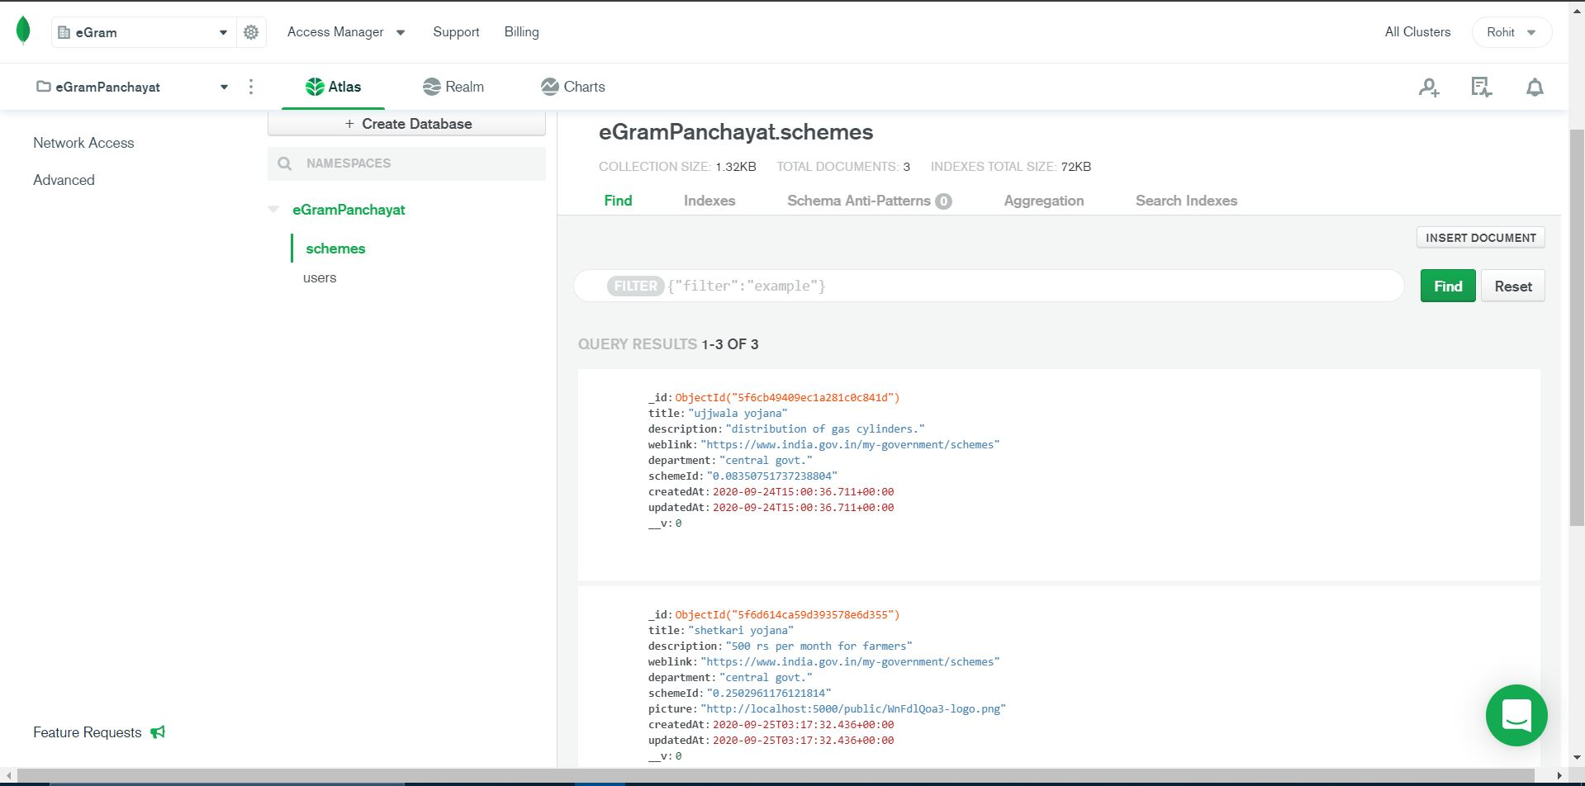
DATABASE SCHEMA FOR SCHEMES MODULE.

Slide 10
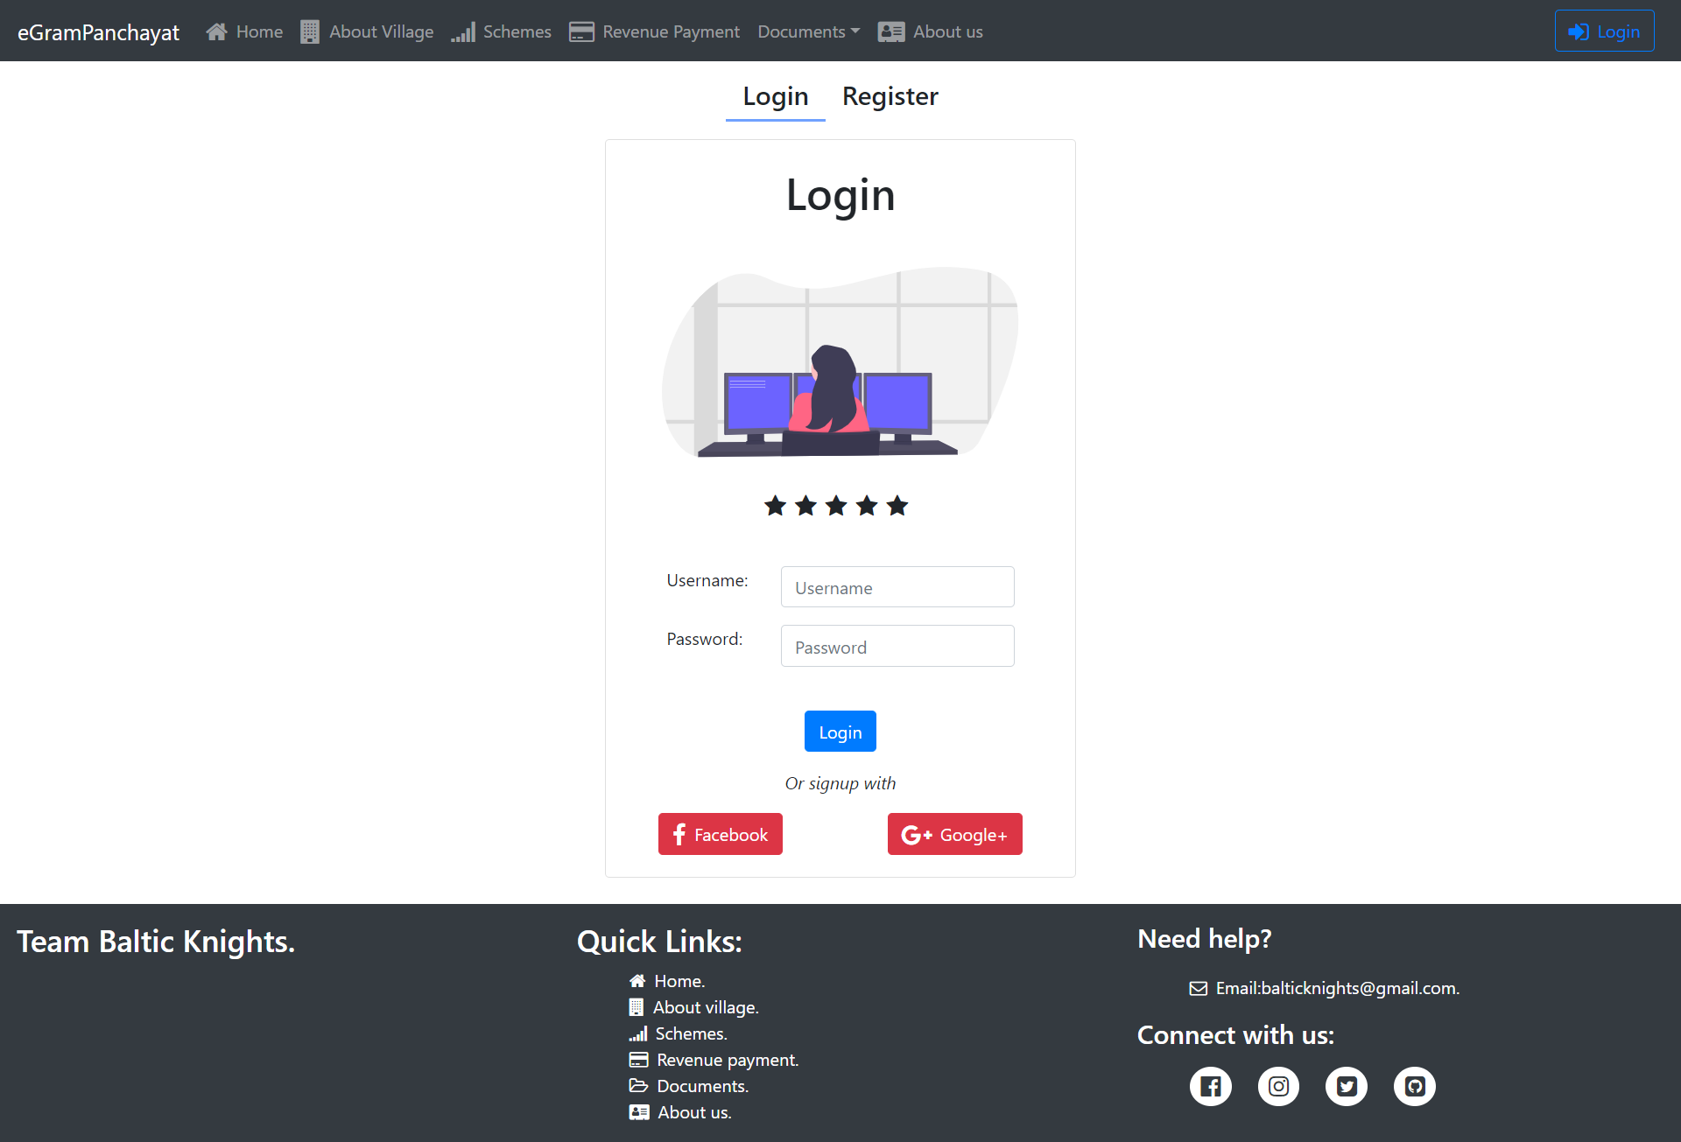
LOGIN PAGE PROTOTYPE.

Slide 11
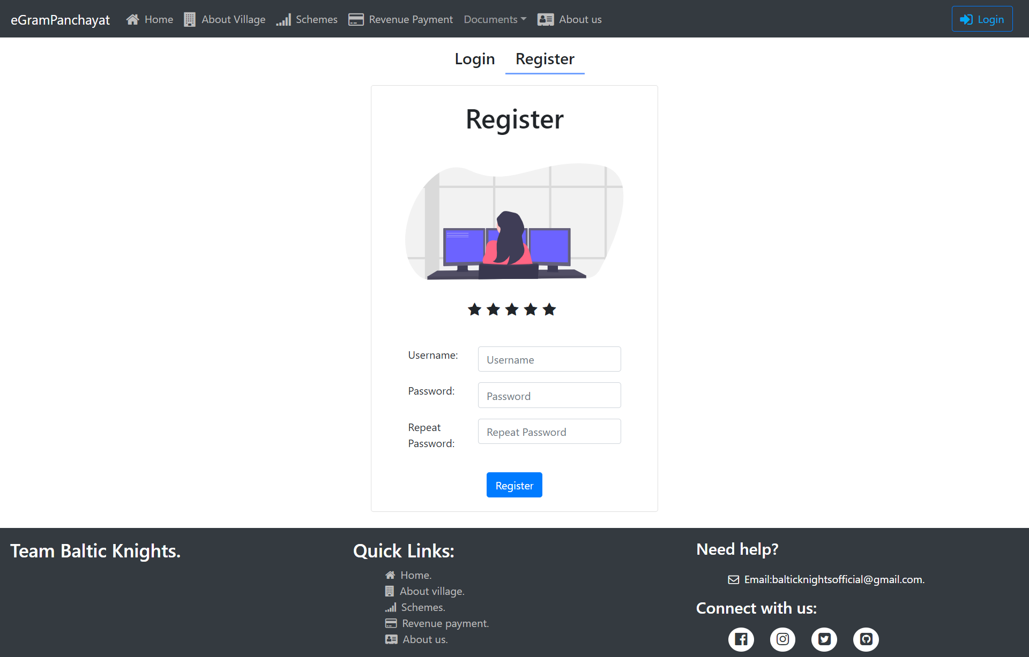
REGISTER PAGE PROTOTYPE.

Slide 12
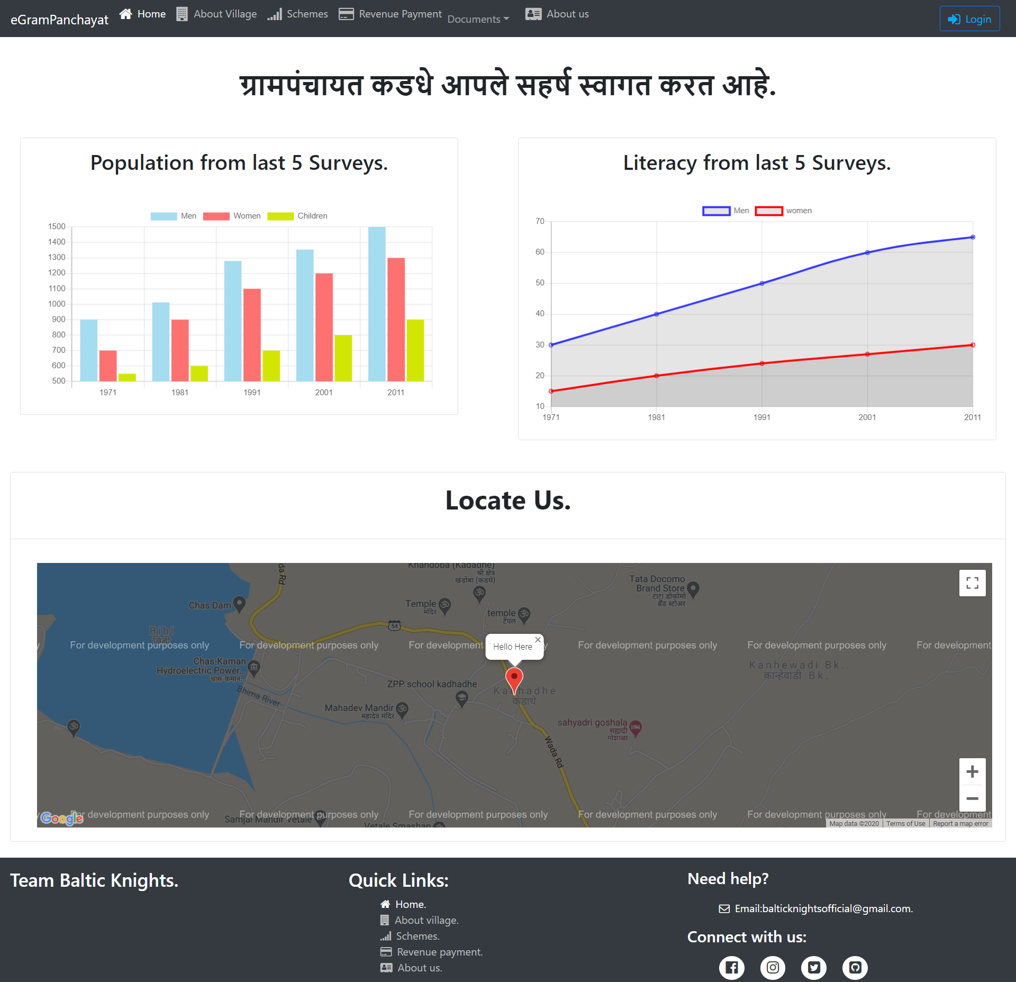
HOME PAGE PROTOTYPE.

Slide 13
TECHNOLOGY STACK.
Front End.
Server side development.
Storage and Hosting.
Networking.
React js:To develop web pages in component form.
Bootstrap,JSX,CSS:For responsive design and styling.
Node js:For secure and robust server development.
Express js:For API Routing.
React Redux:to establish connection with Node js server from client side.
MongoDB:Data will be stored in JSON format.
Amazon AWS:For fast and authenticated web hosting.
API Routing:using express js Routing for get/post requests.
Client-server Archietecture:developing client using React js and Node js for server development.

Slide 14
Suggestions?

Slide 15


THANK YOU
Rohit Naikade (339)
Mehul Lokhande (331)
Vijay Dabhade (308)
Govind Madankar (332)

